Slide 1

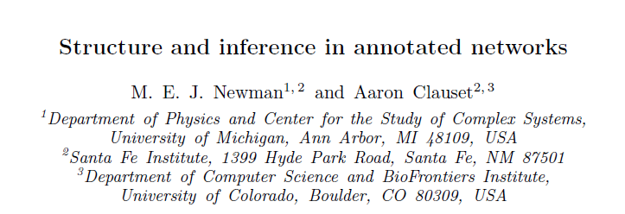
Structure and Inference in annotated networks
STAT 517
Literature Review
Ryan Heiderman

Slide 2
“We focus in particular on the problem of community detection in networks and develop a mathematically principled approach that combines a network and its metadata to detect communities more accurately than can be done with either alone.”
-Newman and Clauset
Published June 16, 2015

Slide 3
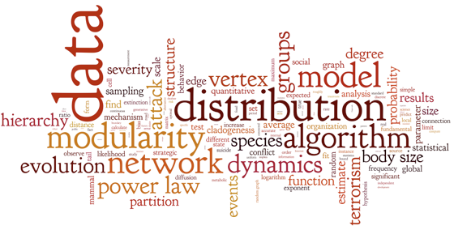
Lit Review
Introduction
Networks and Community Detection
Metadata
Methods
Model Development
Statistics
Results
Model Application and Examples
Synthetic Networks
Real-World Networks
Conclusions
http://tuvalu.santafe.edu/~aaronc/

Slide 4
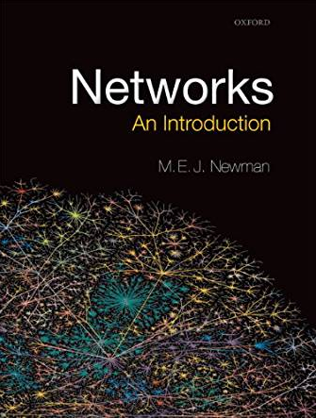
Networks
A powerful and compact representation of the internal structure of a wide range of complex systems.
Social – interactions among people
Technological / Information – the Internet
Biological – molecules, cells, food webs

Slide 5
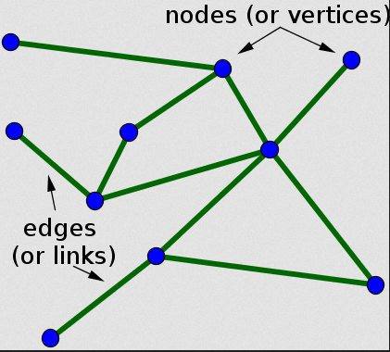
Networks are complicated
How are edges organized?
How do vertices differ?
What processes shape these networks?

Slide 6
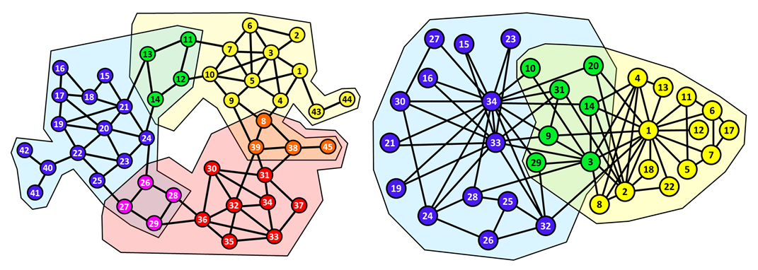
Community Detection
Networks are sets of nodes and their interactions
CD searches for division of nodes into groups or classes
Assortative – connections between similar nodes
Disassortative – between dissimilar nodes

Slide 7
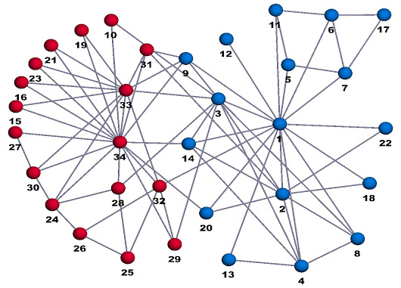
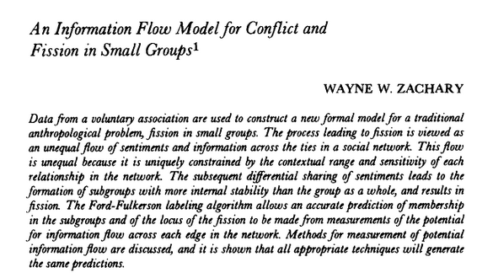
Zachary Karate Club
Allegiances in Social Networks
John A and Mr. Hi
1977

Slide 8
Detecting Communities in Networks
Community detection algorithms are usually informed only by the network structure
Community is strongly correlated with the node classes
Algorithms developed and tested on small real-world networks where classification of nodes is known
Larger real-world networks datasets are becoming available – classic community detection algorithms have performed poorly

Slide 9
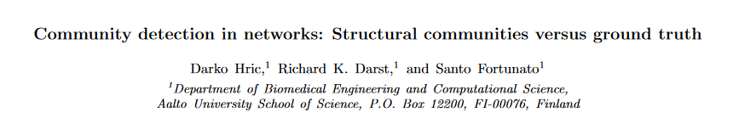
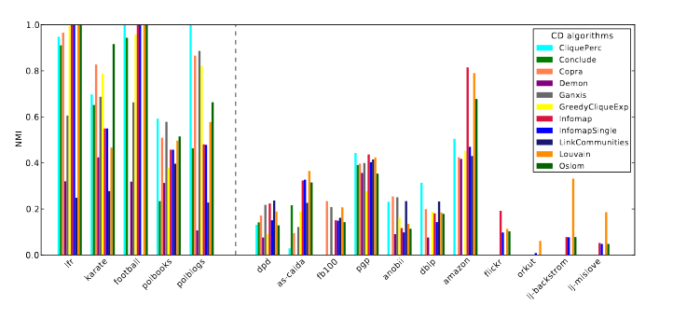
2014

Slide 10
Improve the Models
Build a model to incorporate node metadata into the community detection problem in a principled and flexible manner
Model does not assume a prior correlation between metadata and communities – but seeks to detect and quantify if a relationship exists, then use it to improve results (and ignore if none exists)

Slide 11
Metadata
Social Networks – age, sex, race or ethnicity
Food webs – feeding mode, body mass
Internet – data capacity, physical location
Protein Interactions – molecular weight, association with cancer

Slide 12
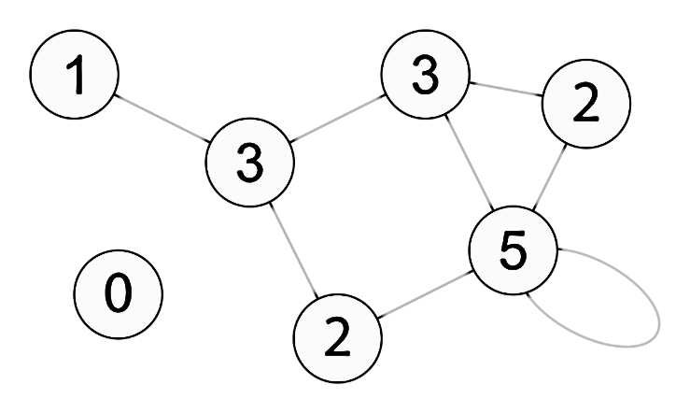
Methods
Stochastic Block Model
Nodes of a network partitioned into subgroups (“blocks”) with distribution of ties between nodes dependent only on the block to which the nodes belong
Too simple for complex real-world networks
Modified Stochastic Block Model (DC-SBM)
“Degree Correction” term
Dependence on node metadata via a set of prior probabilities

Slide 13

Generation
Given metadata x = {x_{u}} and degree d={d_{u}} for each node u
u is assigned a community s with a probability γ_{sx} depending on u’s metadata
Full prior probability on community assignments is:
where Г is k x K matrix of parameters γ_{sx}
given node assignments, place edges independently/randomly with probability:
where p_{uv} is probability of edge being placed between node u and node v
ϴ is the SBM matrix of group-level connection probabilities
d_{u}d_{v} controls the degrees at each vertex

Slide 14
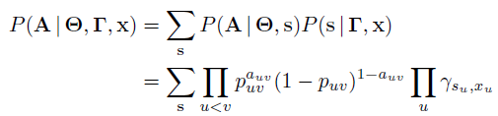
Community Detection with DC-SBM
Given observed network A (adjacency matrix of 1’s and 0’s)
The model likelihood is:
Where ϴ is a k x k matrix of community interaction parameters, and the sum is over all possible community assignments s
Model is fit to data using expectation-maximization (EM) to maximize the left hand, with respect to ϴ and Г
network metadata

Slide 15
Application
Normalized Mutual Information
Synthetic Networks
Computer generated network of known structure
Real-World Networks
School Friendships
Predator-Prey Interactions
Facebook
Malaria Gene Recombination
Internet Graph

Slide 16
NMI
Normalized Mutual Information
Most widely utilized measure of agreement between community divisions and “ground truth”
From 0 (metadata uninformative) to 1 (metadata specify communities perfectly)

Slide 17
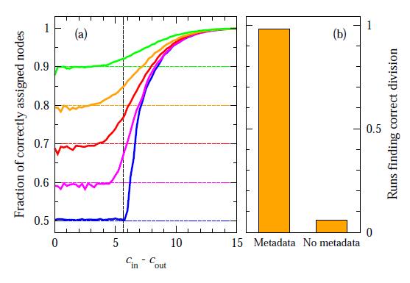
Synthetic Network
Planted Partition Model - Computer generated network of known community structure
Discrete valued node metadata generated at random that match true community assignments of nodes a given fraction of the time.
Edge probabilities for with-in and between groups - strong or weak network structure
Large c_{in} – easy to detect from network structure alone
Metadata + DC-SBM performs better than either
Any algorithm without metadata, or
Metadata alone
n = 10,000 nodes

Slide 18
School Friendships
795 students in a medium sized American high school and its feeder middle school
Network represents patterns of friendship, established by survey
Metadata = grade 7-12, ethnicity, gender
Asked algorithm to divide into 2 communities

Slide 19
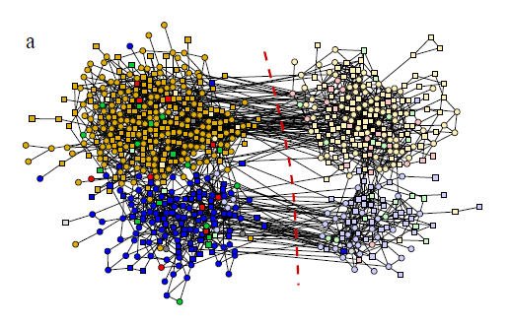
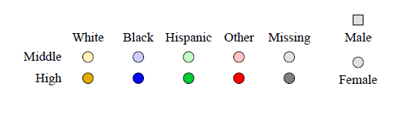
School Friendships – Grade
NMI with metadata = 0.881
NMI w/o = 0.105 – 0.384

Slide 20
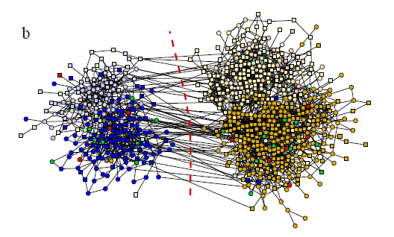
School Friendships - Race
NMI with metadata = 0.820
NMI w/o = 0.120 – 0.239

Slide 21
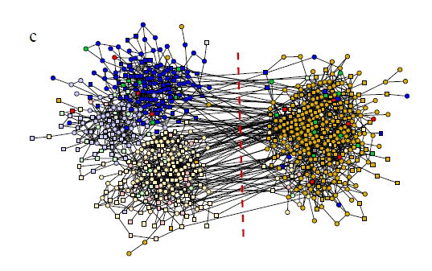
School Friendships – Gender
NMI with metadata = 0.003
NMI w/o = 0.000 – 0.010
Does algorithm just create a network from metadata?
Gender revealed no good partition between male and female.
Algorithm ignored metadata in this case

Slide 22
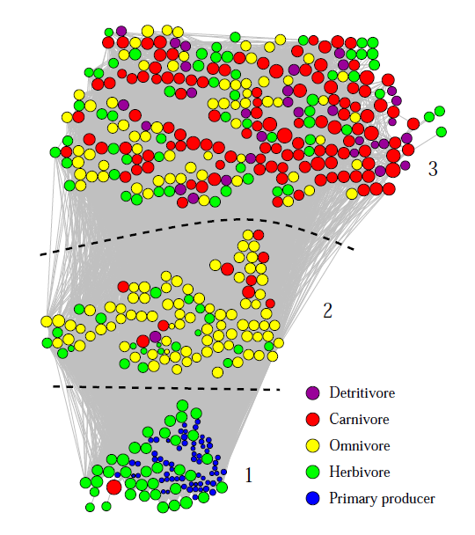
Predator-Prey Interactions
488 marine species in Weddell Sea off Antarctica.
Metadata = Feeding mode, Ocean Zone, Body Mass
Divide into 3 communities
NMI with meta = 0.595
NMI w/o = 0.348 – 0.443

Slide 23
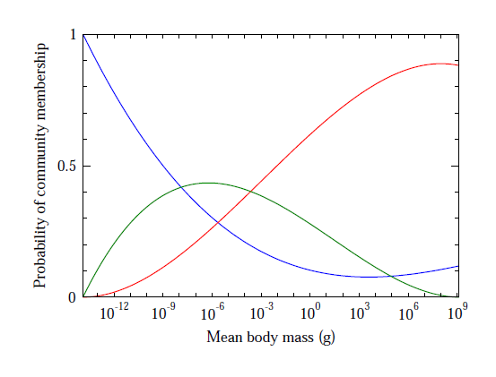
Predator-Prey Interactions
Ordered metadata
Recovered known correlation between body mass, trophic level and ecosystem role

Slide 24
Facebook Friendship
FB100 dataset

Slide 25
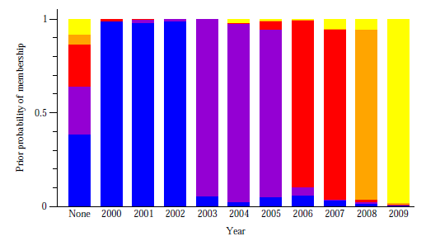
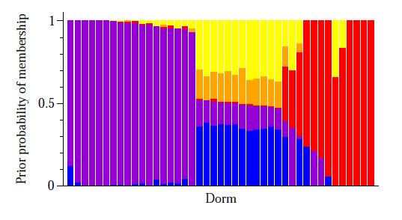
Facebook Friendship
From 2003-2009, Harvard, 15,126 students
Graduation year and Dorm, 5 divisions
NMI with meta = 0.668
NMI w/o = 0.573 – 0.641
NMI with meta = 0.255
NMI w/o = 0.074 – 0.224

Slide 26
Malaria Gene Recombination
P. falciparum, responsible for malaria, prolongs infection by repeatedly changing a protein camouflage displayed on the surface of an infected red blood cell
Recombination occurs within a number of distinct highly variable regions (HVRs)
Focus on HVR 5 and HVR 6 subnetworks
Cys labels and Cys-PoLV (CP) labels
Network of 297 genes

Slide 27
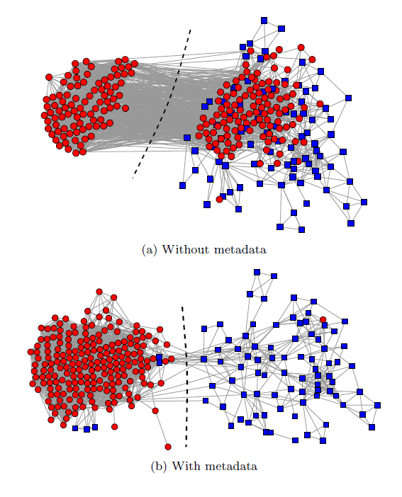
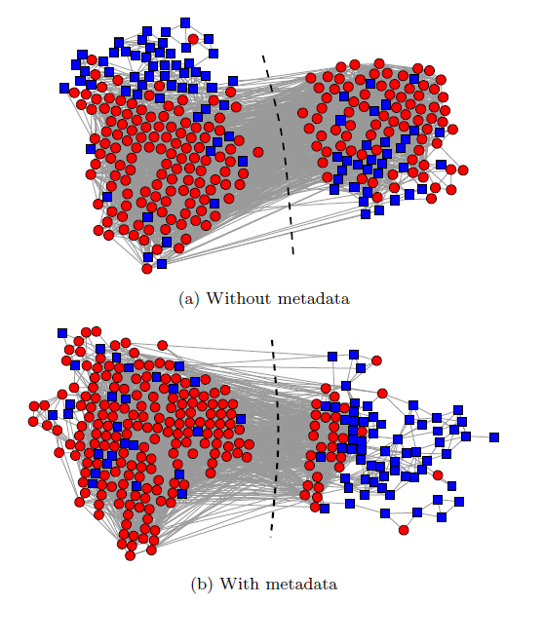
Malaria Gene Recombination
NMI with = 0.596
NMI w/o = 0.077 – 0.675
HVR 6
HVR 5
Color is Cys label which indicates cysteine structure

Slide 28
Internet Graph
46,676 node representation of the peering structure of the Internet at the level of autonomous systems
173 countries – significantly larger number of divisions than any other test of the algorithm

Slide 29
Internet Graph
Find 5 communities
NMI values without metadata range from 0.398 to 0.626
Showing that there are many competing network divisions that could be discovered from simple algorithms
NMI with metadata was 0.870
The algorithm is not forced to find a community division that aligns with metadata, but if a division does exist it will be favored over competing divisions that do not align with metadata

Slide 30
Conclusions
Problems with community detection
Complex, large networks are tough to describe
DC-SBM with metadata allows for selection among competing divisions
Automatically choose to use or ignore metadata as appropriate
Infer correlation between network structure and metadata
Application to a range of community types

Slide 31
Conclusions – Future Suggestions
The authors describe a number of extensions of their work:
More complex metadata types – combinations, spatial coordinates
Detection of different structure types – hierarchy, rankings
Prediction of missing metadata in incomplete datasets

Slide 32
References
M.E.J. Newman and A. Clauset. 2015. Structure and inference in annotated networks. Nature Communications.
M.E.J. Newman. 2010. Networks: An Introduction. Oxford Press.
D. Hric, R.K. Darst and S. Fortunato. 2014. Community detection in networks: Structural communities versus ground truth. Phys. Rev.
B. Karrer and M.E.J. Newman. 2010. Stochastic blockmodels and community structure of networks. Phys. Rev
W.W. Zachary. 1977. An information flow model for conflict and fission in small groups. Journal of Anthro Research

